Slide 1
Mystery Shopping For Store Evaluation,,,,
By Shrinivas Barshikar

Slide 2
Flagship Stores vs Stores at Malls TOOLS : Python, Excel (Pivot tables, Pivot Charts), Power-BI
PROBLEM STATEMENT : A leading luxury watch brand has observed decline in their customer satisfaction in the Stores located in Malls when compared to Flagship Store.
Mystery Shopping was conducted for both type of Stores, and 30 different Evaluators were sent to different regions of the word where the watch brand was located.
Each evaluator was provided with a questionnaire to understand customer satisfaction and overall experience, where the evaluators also narrated their whole experience and highlighted areas of improvement for Stores at Malls and Flagship stores.
Evaluators gave Evaluation Score for each store from different regions along with few other scores for Exterior, In Store, Sale Closure & Comfort of Shopping at the store.

Slide 3
Scores given by Evaluators for Different Regions

Slide 4
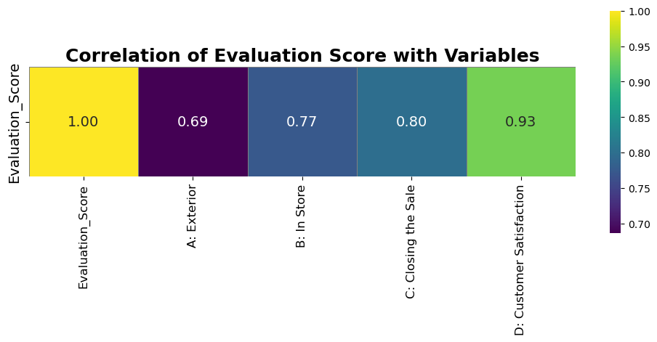
Correlation between Evaluation Score and Other Scores
Correlation between Evaluation Score and Other scores like Exterior, In store, Sales and Comfort was calculated to understand whether the overall evaluation scores were affected by the scores given for various aspects of the store.
Correlation between (0.5 to 1) is considered as strong positive correlation.

Slide 5
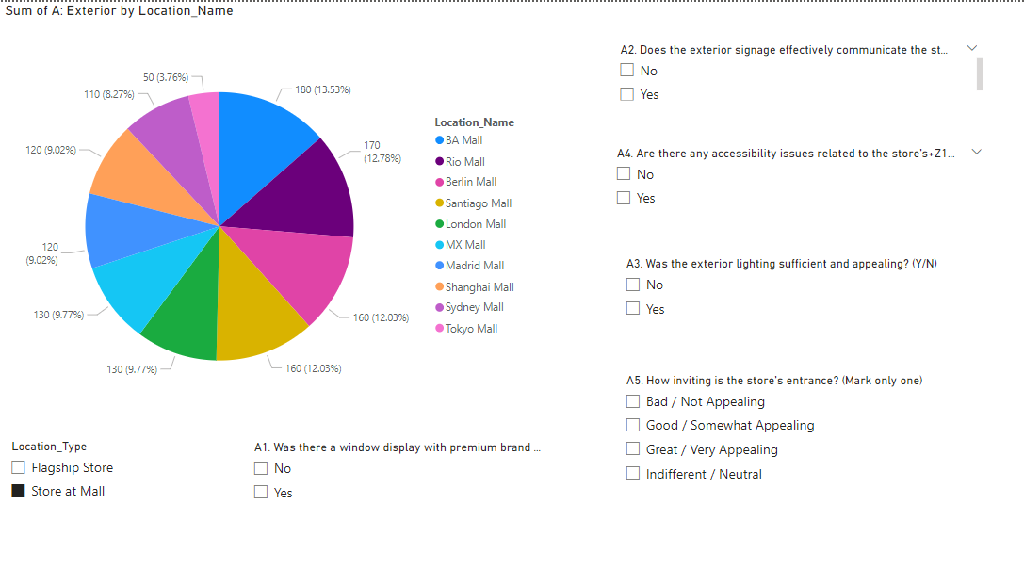
Exterior Aspects of Stores at Malls

Slide 6
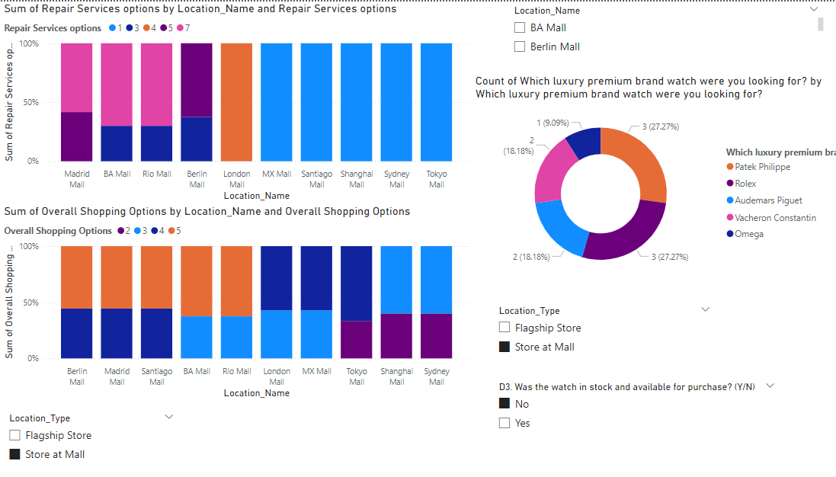
In-store Aspects of Stores at Malls

Slide 7
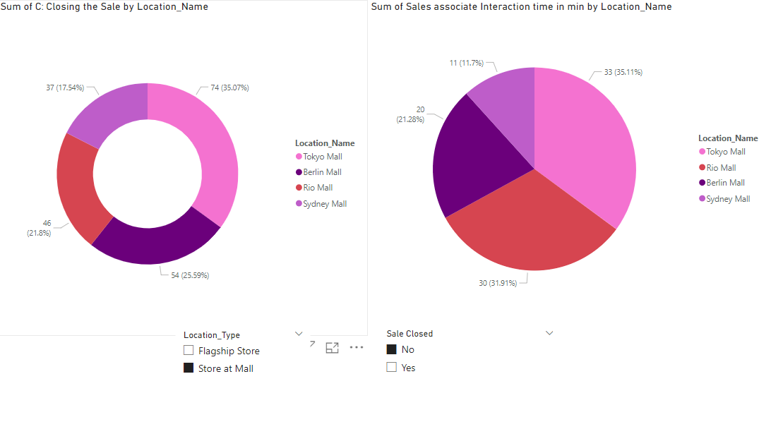
Closed Sales of Stores at Malls

Slide 8
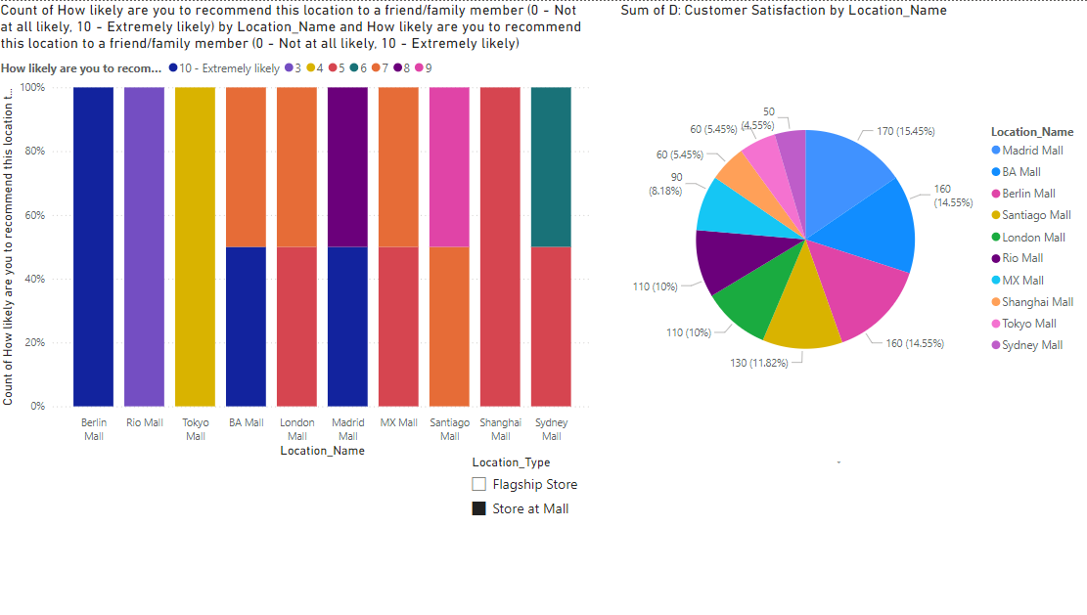
Satisfaction Level of Customers in Stores at Malls

Slide 9
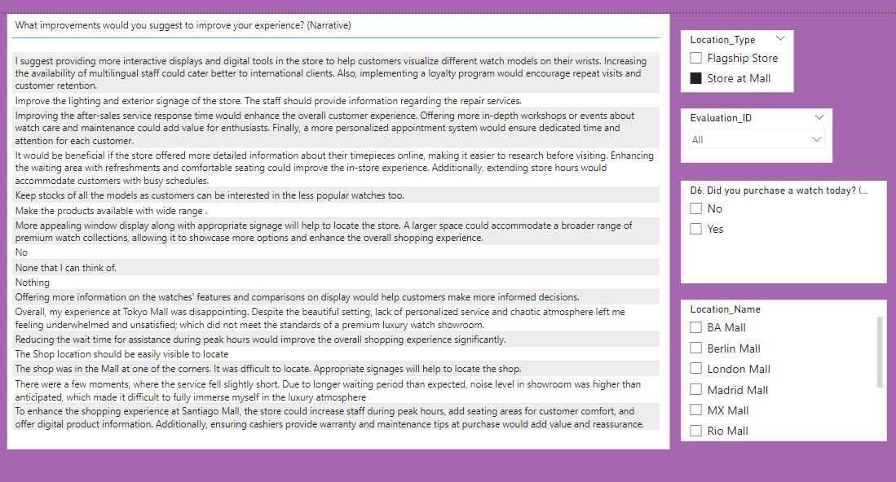
Areas of Improvement for Stores at Malls given by Evaluators

Slide 10
CONCLUSION AND SOLUTION
Flagship stores have better sales than Stores at malls because of aspects like Exterior, Inside Store, and Sales.
Shanghai Mall and Tokyo Mall need to improve exterior lighting and entrance . Where, London Mall and Tokyo Mall can improve their accessibility and exterior signage which come under the category of stores at malls.
Tokyo, Shanghai and Sydney Malls should increase shopping and repair services options. And these malls should increase Omega, Rolex and Patek Phillippe stocks.
Sales associates in Tokyo, Rio, Berlin and Sydney Mall should increase and improve their interaction time with customers.

